Slide 1
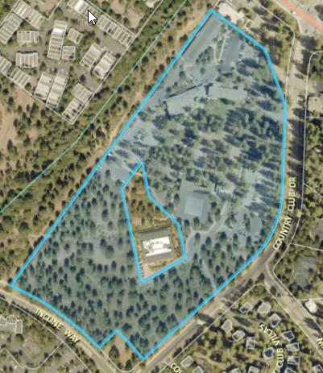
WADMIN19-0017 (Tahoe Forum)
Washoe County Board of Adjustment
September 5, 2019

Slide 2
Request
This is a request for an administrative permit to allow for an outdoor community event business license, with conditions, for the Tahoe Forum, an outdoor community event to be held at the Sierra Nevada College on October 5th
The event qualifies as an “outdoor community event” under Washoe County Code (WCC) Section 25.272 and WCC Code 110.310.20 requires an Administrative Permit for an outdoor event

Slide 3
Background
The Tahoe Forum, as a part of their speaker series, is hosting speaker Maya Musk on October 5th from 2 pm to 3:30 pm
It is estimated that 650 to 700 people will attend the event
The event is free and open to the public

Slide 4
Event Details
A 50 x 100 foot open air tent will be set up on the campus adjacent to Patterson Hall for the event
The tent will be provided by Camelot Party Rentals and required permit for the tent will be obtained
Parking will be available on the college campus, Cornerstone Church, Incline Village GID parking lot and along Country Club Drive and Incline Way
Directions to the parking areas will be provided by parking attendants
No food will be served at the event
Restrooms will be available in Patterson Hall and Prim Library

Slide 5
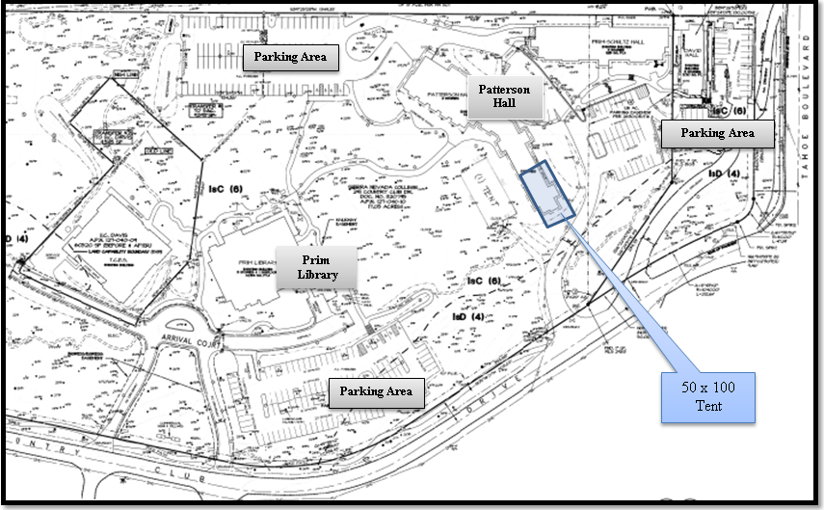

Slide 6
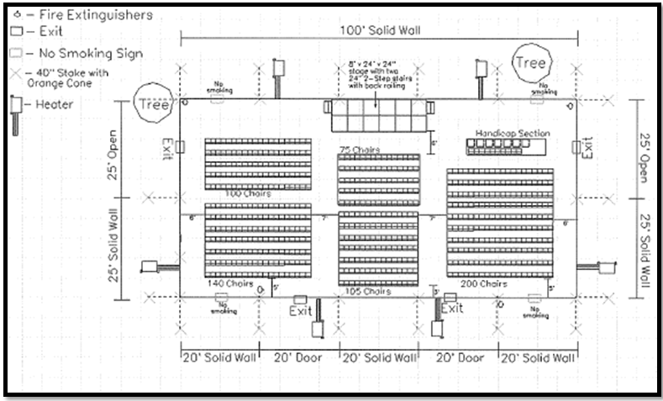

Slide 7
Public Notice & CAB
Public notice was sent to parcels within 500 feet from the site
The Incline Village/Crystal Bay CAB was scheduled to hear the item on September 3rd however there wasn’t a quorum and there was no CAB recommendation on the event
The applicant was present and provided information on the event

Slide 8
Reviewing Agencies
Various agencies reviewed the application, their comments are included in the staff report
Agencies with conditions, are included in the Conditions of Approval

Slide 9
Administrative Permit Findings
Consistency;
Improvements;
Site Suitability;
Issuance Not Detrimental
Staff is able to make the 4 required findings, as shown in the staff report on page 6 and recommends approval

Slide 10
Possible Motion
I move that, after giving reasoned consideration to the information contained in the staff report and information received during the public hearing, the Board of Adjustment approve Administrative Permit Case Number WADMIN18-0017 for the Tahoe Forum, having made all five findings in accordance with Washoe County Development Code Section 110.808.25 and authorize the Director of the Planning and Building Division to issue an outdoor community event business license pursuant to WCC 25.272 when all pre-event conditions have been completed.

